Slide 1
Freelance Session 1
Foundation session
Freelance Sessions

Slide 2
Freelancing Mindset
A lot more money can be made with a quick workflow than with a high price margin
Developer A completes 5 small projects in a day for 500$ each by selecting clients who meet his/her workflow
Developer B completes 1 small project in a day for 1500$ without a workflow
Freelance Sessions

Slide 3
Best practices for Managing big projects
Plan and Prioritize in Azure Task board, Trello or equivalent:
Regular Communication, share your task board with the client:
Testing and QA:
Scope and Time Management:
Client Handoff:
Post-launch Support:
Create a project plan, break it into smaller tasks, and set realistic deadlines.
Maintain open communication with the client to keep them informed.
Test your code thoroughly and document it, including a README file.
Manage scope creep to prioritize tasks
Provide all necessary files and documentation to the client for project maintenance.
Offer post-launch support for a specified period.
Freelance Sessions

Slide 4
Upwork VS. Your Ads
Finding Clients on Upwork
Pros:
Built-in trust and payment protection.
Less marketing effort required.
Cons:
High competition.
Upwork fees reduce earnings.
Finding Clients via Your Ads
Pros:
Potential for higher earnings.
Cons:
Initial marketing effort and cost.
Building trust takes time without platform credibility.
Freelance Sessions

Slide 5
Upwork VS. Your Ads - Process
Upwork Client Acquisition:
Create a profile.
Bid on jobs.
Wait for client selection.
Communicate, work, and get paid.
Clients from Your Own Ads Acquisition:
Set up marketing.
Attract clients.
Communicate, negotiate, and work.
Build relationships and manage payment independently.
Freelance Sessions

Slide 6
Upwork VS. Your Ads - Clients
Finding Clients on Upwork
Pros:
Built-in trust and payment protection.
Wide variety of projects.
Cons:
Clients from Your Ads
Pros:
Targeted client selection.
Cons:
Initial skepticism.
Communication challenges.
Freelance Sessions

Slide 7
Upwork VS. Your Ads – Admin work
Upwork
Upwork handles
Clients from Your Ads
You manage
Flexibility in setting
payments,
contracts,
dispute resolution.
contracts,
payments
terms
policies.
Freelance Sessions

Slide 8
Upwork Connects
You receive 50 connect tokens upon registration with Upwork
Used for bidding on projects – projects require 8 tokens per bid on average
Can bid on 6 projects in first month with free tokens
10 Connect token = Rs 66
1 bid = Rs 66
Connect tokens last 1 year
Freelance Sessions

Slide 9
Upwork Connects
You receive 50 connect tokens upon registration with Upwork
Used for bidding on projects – projects require 8 tokens per bid on average
Can bid on 6 projects in first month with free tokens
10 Connect token = Rs 66
1 bid = Rs 66
Connect tokens last 1 year
Freelance Sessions

Slide 10
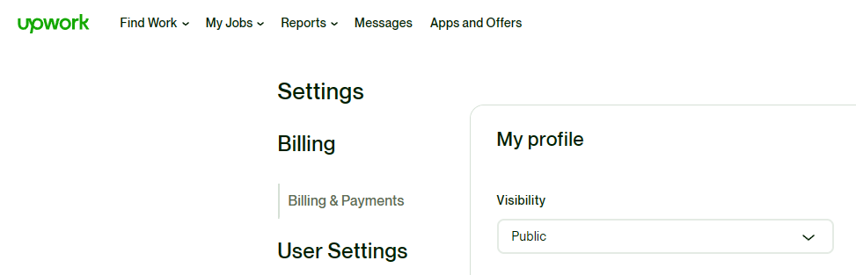
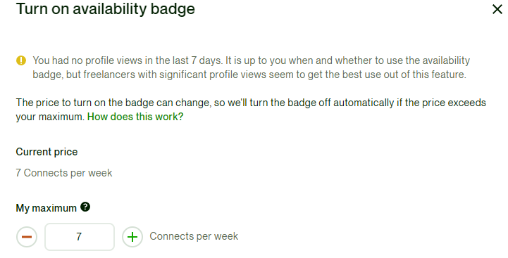
Upwork Tips
Your upwork profile skills and title need to match your bid
so keep updating your profile with every bid
Set Profile visibility as Public
Turn on availability on minimum connects/week
Freelance Sessions

Slide 11
Upwork Tips
Add non-upwork testimonials on Upwork,
send testimonials requests from upwork
Everyday, search jobs on upwork which
fewest bids and apply to them
perfectly match your skillset,
Freelance Sessions

Slide 12
Upwork Tips
When you start, you need to get into projects with fewest bidders
to have good ratings on your Upwork profile.
to get familiar with working freelance
to build your portfolio
Write a good cover letter when applying to an upwork job
Once you get selected and finally talk to the client, screen your employer to
see if you can work with them
Freelance Sessions

Slide 13
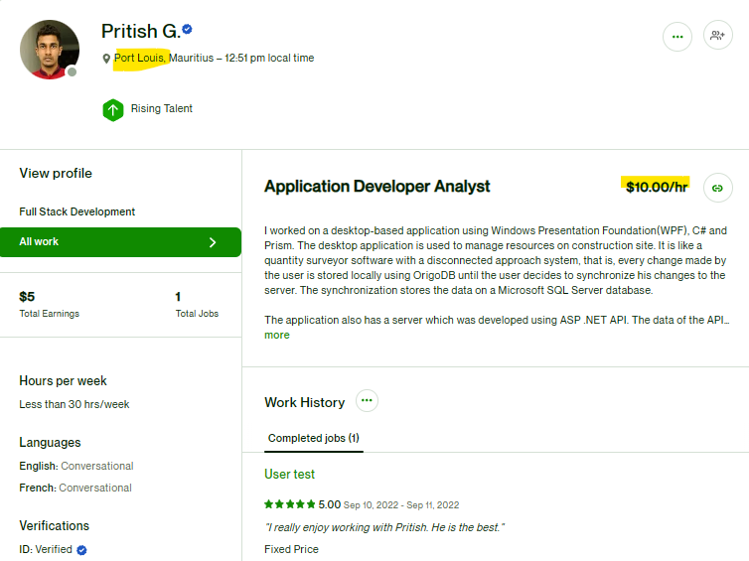
Mauritius Freelance Web devs – Hourly Rate
$10/hr
Freelance Sessions

Slide 14
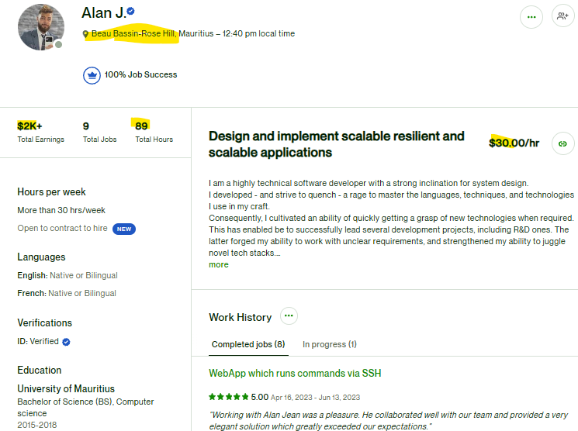
Mauritius Freelance Web devs – Hourly Rate
$30/hr
Freelance Sessions

Slide 15
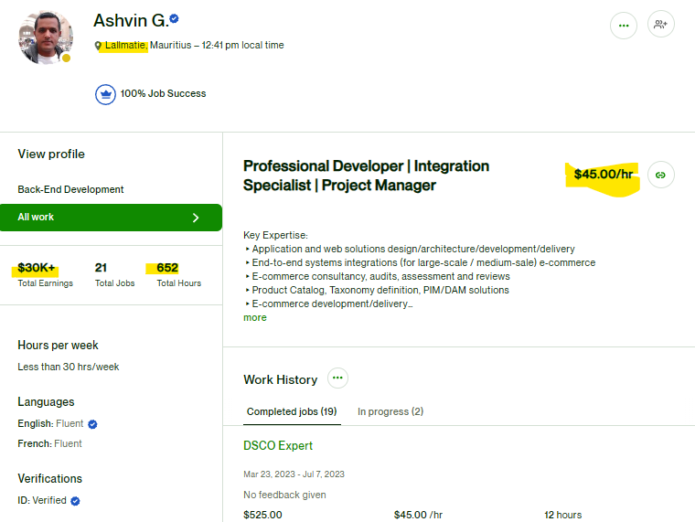
Mauritius Freelance Web devs – Hourly Rate
$45/hr
Freelance Sessions

Slide 16
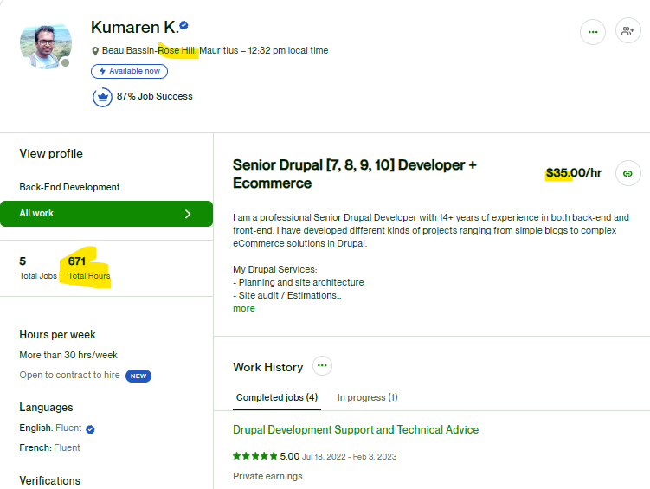
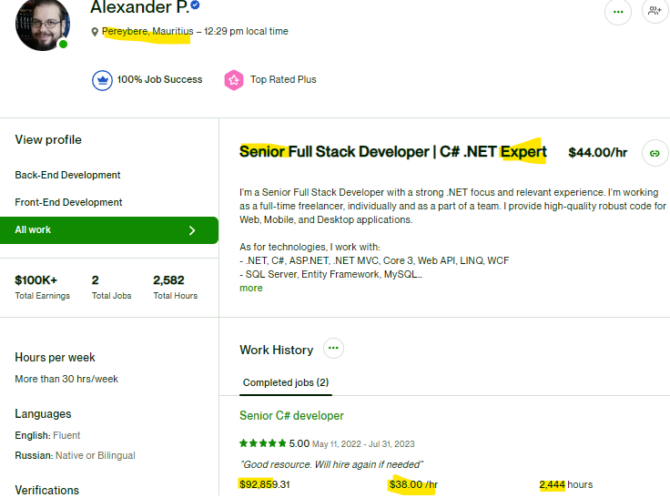
Mauritius Freelance Web devs – Hourly Rate $35/hr - $44/hr
Freelance Sessions

